Slide 1
Woodlands CS club meeting #2 (contest programming)
10/19/2020

Slide 2
Table of Contents
Take up last week’s problems (Geneva Confection)
Time complexity analysis
Prefix sum array
DMOPC '14 Contest 2 P4 - Deforestation
DMOPC '20 Contest 1 P2 - Victor's Moral Dilemma
Difference array (extension of prefix sums)
Battle Positions
Prerequisites: arrays and loops

Slide 3
Geneva Confection
Understand the problem statement
What is it asking us to find out?
Brainstorm ideas to solve this problem

Slide 4
Geneva Confection
Idea:
We keep one stack for the mountain top and one stack for the branch.
We keep a counter which stores which number we are currently on.
In the input we just push everything into the mountain top stack.
For every iteration of our counter (while counter != N):
Are there elements in our branch stack? If so, is the top element in our branch == counter? If so, increment our counter and pop the top element of our branch
Are there elements in our mountain top stack? If so, is the top element of our mountain top == counter? If so, increment the counter and pop the top element of our mountain top.
If the current number we are on (counter) is not equal to the top of the branch or the mountain top, then we move the top element of our mountain top to the branch
If at any point, our mountain top is empty and our top element in the branch is not equal to our current number, then it is impossible, and we should output no.

Slide 5
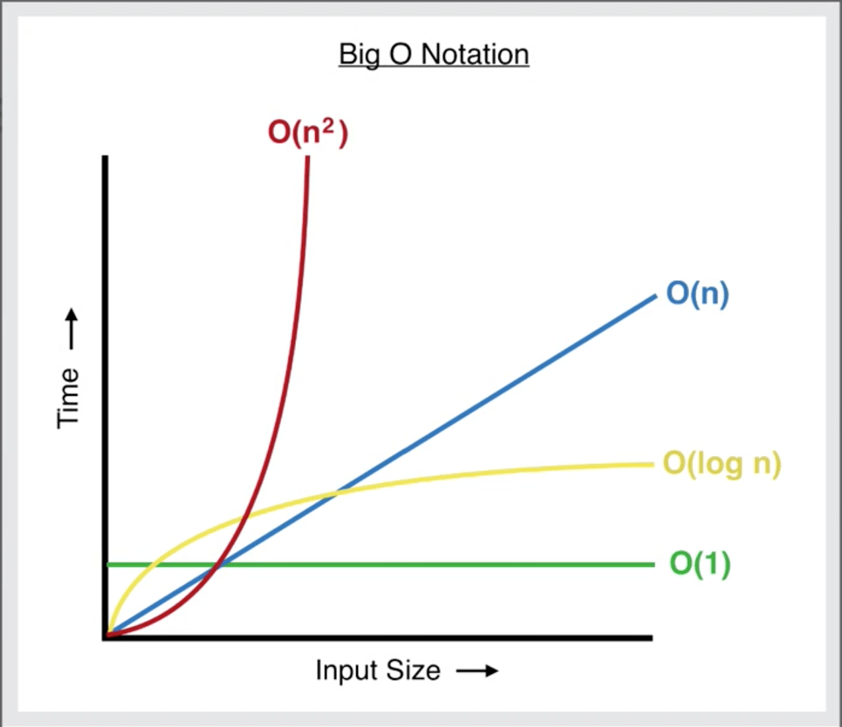
Time complexity analysis
Basically a line
Typically can do around 4 * 10⁸ instructions
Can sometimes get away with more ex. People managed to solve CCC20S2 with n^2 * sqrt(n) time complexity = 10^9 operations worst case
CCC people sometimes screw up when making data
It’s always better to guess / try random stuff if you have no other ideas

Slide 6
Uses of Time Complexity
Almost all questions have a time limit + memory limit for our program.
Instead of coding up an entire solution, and realizing that it is too slow or uses too much memory, we can use complexity analysis to estimate if our idea will pass.
This saves us time (do not have to implement entire solution).
Once you practice complexity analysis, you can find calculate it in a few seconds.

Slide 7
Time Complexity (Cont.)
Time complexity represents the amount of memory and runtime a program will take/use as the constraints of the input reach its limits.
In other words, time complexity analysis only considers the worst case scenario for runtime and memory usage.
We represent time complexity in something known as Big O Notation.
In Big O Notation, we ignore all coefficients and only include the highest order.
STEPS: O(2N^2 + 4N^4 - 3)
O(2N^2 + 4N^4 - 3) → REMOVE ALL COEFFICIENTS → O(N^2 + N^4 - 3)
O(N^2 + N^4 - 3) → INCLUDE ONLY HIGHEST ORDER → O(N^4)

Slide 8
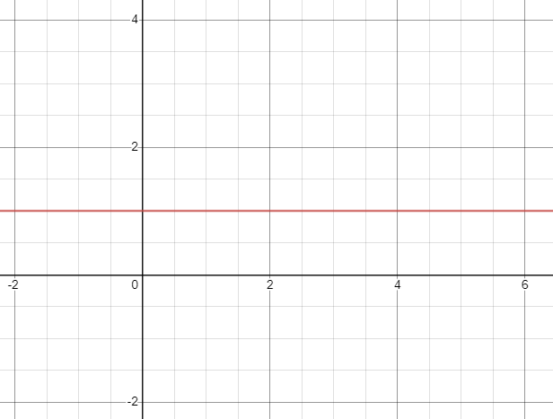
Constants - O(1)
No correlation to size of input
Applications are:
Basic Arithmetic Operations (addition, multiplication, bitwise operations)
If statements
Reading integer input

Slide 9
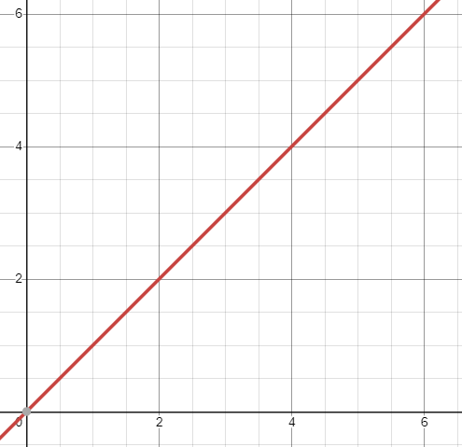
Linear - O(N)
Does have correlation to the size of input
Program will not TLE if N <= 50000000
Applications are:
For loop from 1 to N
Reading an input array

Slide 10
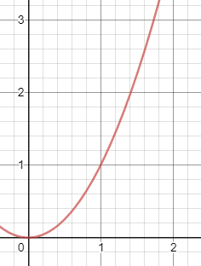
Quadratic - O(N^2)
Does have correlation to the size of input
Program will not TLE if N <= ~8000
Applications are:
Nested for loops
Reading input 2D array of size N*N

Slide 11
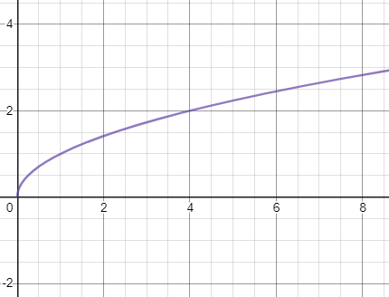
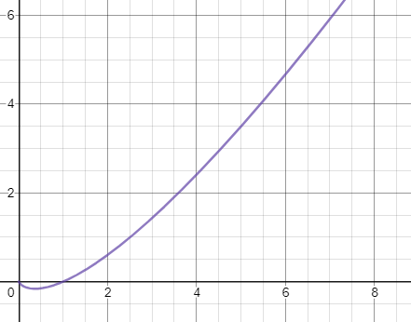
Square Root - O(sqrt(N))
Program will not TLE if N <= ~5 * 10^14
Applications are:
Primality testing
Linearithmic - O(N log N)
Program will not TLE if N <= 1,000,000
Applications are:
Built-in sort functions

Slide 12
How to calculate?
The easiest way to calculate time complexity is to count the number of nested for loops there are in your program.
If you have P nested for loops in terms of N - O(N^P)
Examples are:
If you have one for loop from 1 - M nested in a for loop from 1 - N : O(NM)
If you have a for loop from 1 - N nested in a for loop from 1 - N : O(N^2)
If you have three for loops nested in one another all from 1 - N: O(N^3)

Slide 13
EXAMPLES:
O(N)
arr=[]
n=int(input())
for i in range(n):
ele=int(input())
arr.append(ele)
O(N^2)
n=int(input())
for i in range(n):
for j in range(n):
if((i + j) % 2):
# do something
pass
O(NM)
n=int(input())
m=int(input())
arr=[[0 for i in range(m+1)]for j in range(n+1)]
for i in range(n):
for j in range(m):
ele = int(input())
arr[i][j] = ele

Slide 14
Final Applications
Once we have the final complexity of our program (eg. O(N)), we can plug in the upper limit of these values into the equation.
For example, if the question stated:
And the time complexity of our idea was O(NQ), we could plug the max value of N and Q in:
O(1,000,000 * 1,000,000) = 10 ^ 12
Since this is far greater than 50,000,000, we know this solution will TLE, and instead of implementing it, we should try to think of other ways to solve the given problem.
If our solution was O(N) though, we can plug it in, and see that O(1,000,000) < 50,000,000, and that our solution will not TLE and pass.

Slide 15
DMOPC '14 Contest 2 P4 - Deforestation
Problem Link: https://dmoj.ca/problem/dmopc14c2p4
You are given an array of N elements (1 ≤ N ≤ 1000000), and Q queries (1 ≤ Q ≤ 1000000). Each query gives two indices, a and b, and you are to output the sum of the elements between indices a and b (inclusive).
EXAMPLE:
Query = 0 4
Output: 15
Note that you are given up to 1 million queries, and this example just shows the sample output for one such query.
Index | 0 | 1 | 2 | 3 | 4
Mass | 1 | 2 | 3 | 4 | 5

Slide 16
DMOPC '14 Contest 2 P4 - Naive solution
The naive (brute force) solution to this problem is for every query, loop from indices a to b to calculate the sum.
The time complexity of this algorithm is O(n^2) though. This is because the worst case scenario for this problem is N = 1000000, Q = 1000000, and for each query, a = 0 & b = 999999. This results in 1000000 * 1000000 total operations, or 1 trillion operations.
This is far too slow as DMOJ can handle ~50,000,000 operations per second (~340 minutes to run).
How can we handle queries in constant time (or in other words, not have to loop from indices a to b to find sum)?

Slide 17
Introduction to Prefix Sum Arrays
Motivation: O(n) precompute to find sum of any range in O(1) or constant time
If you’re familiar with inclusion-exclusion from math contests, this is pretty much the same thing
Can also be extended to any reversible operation
Works on operations like addition, subtraction, multiplication, xor
Won’t work on GCD, bitwise and, etc
Can also be extended to larger dimensions (2D, 3D, 4D, KD arrays)
Kind of a simplification of hashing, which can be used on CCC‘20 S3 and CCC‘15 J5(cheese)
Can be used on CCC‘20 S4

Slide 18
Introduction to Prefix Sum Arrays Cont.
A prefix sum array is an array related to the original array in a way such that any index i in the prefix sum array stores the cumulative sum of all elements in the original array from 1 to i.
Assuming the i-th element of the prefix sum array is PSA[i],
Then PSA[i] is defined as orig[1] + orig[2] + orig[3] + … + orig[i]
Let us better understand this with a visualization.

Slide 19
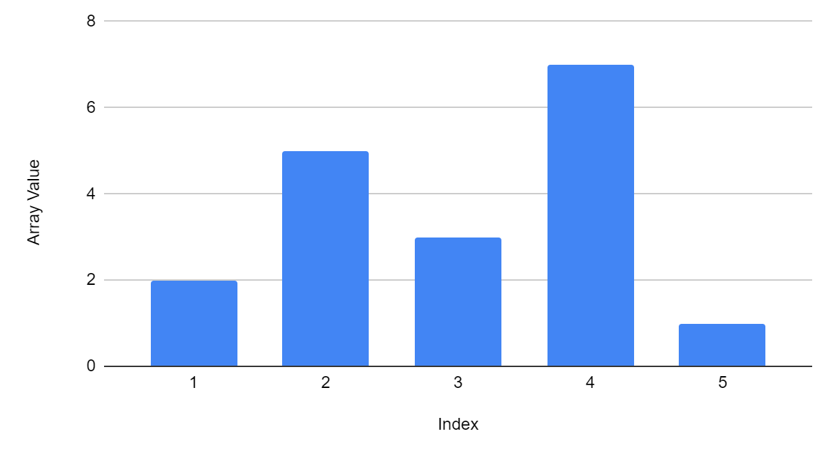
Visualization of PSA
Example Array:
Index | 1 | 2 | 3 | 4 | 5
Array | 2 | 5 | 3 | 7 | 1
Let us do a PSA on this original array.

Slide 20
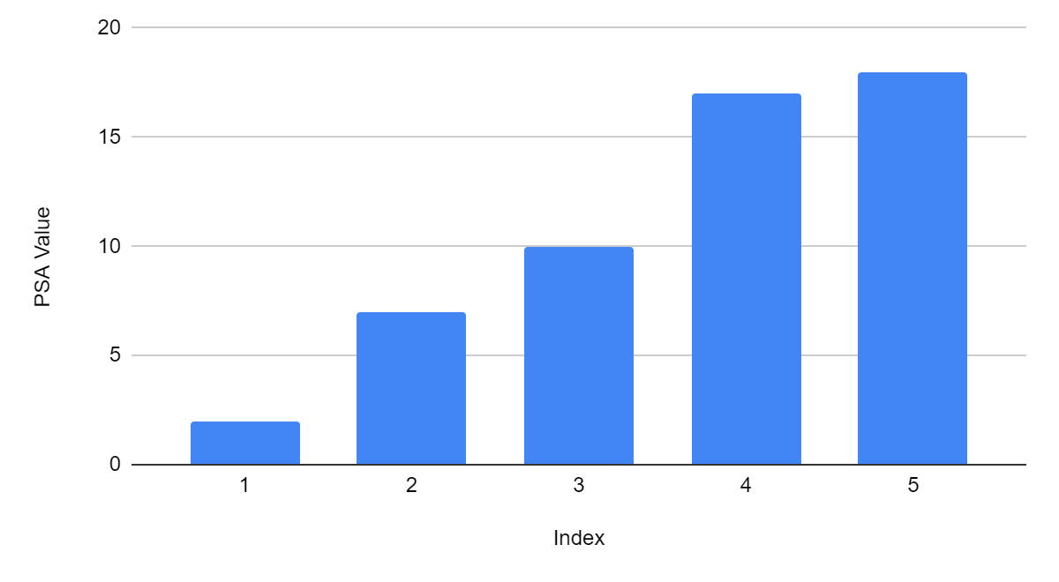
Visualization of PSA
Example Array:
Index | 1 | 2 | 3 | 4 | 5
Array | 2 | 5 | 3 | 7 | 1
PSA | 2 | 7 | 10 | 17 | 18

Slide 21
Applications of a Prefix Sum Array
After we construct a prefix sum array, we can find the sum of an interval [a, b] in constant or O(1) time.
If we query PSA[b] - PSA[a-1], we will find the sum of the interval [a, b] in the original array.
Why?
PSA[b] stores the sum of all elements from 1 to b (arr[1] + arr[2] + … + arr[b])
PSA[a-1] stores the sum of all elements from 1 - a-1 (arr[1] + arr[2] + … + arr[a-1])
If we subtract PSA[a-1] from PSA[b] then, we are getting the sum of all elements from a to b.
a
b
a
b
a-1

Slide 22
Building Prefix Sum Array
We can construct a PSA in O(n) time.
If we were to loop from 1 - i for every PSA[i], our building algorithm would take O(n^2), which is not an improvement in speed.
Instead, for every index, we can say that:
PSA[i] = PSA[i-1] + orig[i]
Since PSA[i-1] = orig[1] + orig[2] + … + orig[i-1]
Then PSA[i] = orig[1] + orig[2] + … + orig[i-1] + orig[i]
Also note that your original array and prefix sum array should be 1-indexed, meaning that the array starts at index 1. This is to avoid PSA[i-1] being a negative index.

Slide 23
Template PSA Code (Deforestation)
PYTHON
CPP
#include <bits/stdc++.h>
using namespace std;
int orig[1000005], PSA[1000005], N, Q, a, b;
int main() {
cin >> N;
for(int i = 1; i <= N; i++) {
cin >> orig[i];
}
for(int i = 1; i <= N; i++) {
PSA[i] = PSA[i-1] + orig[i];
}
cin >> Q;
for(int i = 1; i <= Q; i++) {
cin >> a >> b;
a++; // add one since queries are 0-indexed
b++;
cout << PSA[b] - PSA[a-1] << "\n";
}
}
n=int(input())
orig=[0] # 1-indexed, add element at start of array
for i in range(n):
orig.append(int(input()))
PSA=[0]
for i in range(1, n+1):
PSA.append(PSA[i-1] + orig[i])
for i in range(int(input())): # loop through each query
a,b=map(int,input().split())
a+=1 # add one since queries are 0-indexed
b+=1 # but PSA should be 1 indexed
print(PSA[b]-PSA[a-1])
If you are still TLEing with Python/CPP, consider using fast input:
In Python this means adding:
import sys
input=sys.stdin.readline
to the top of your code
In CPP this means adding:
cin.tie(0);
cout.tie(0);
cin.sync_with_stdio(0);
at the top of your main function

Slide 24
Difference Arrays
Motivation: O(n) precompute for range update queries in O(1) time
The difference array stores only the first differences of an array instead of the sum of the prefixes
Dif[i] = A[i] - A[i-1]; (if i==0, Dif[i] = A[i])
If A = [5, 6, 3, 7, 2, 9], then
the resulting Dif = [5, 6-5, 3-6, 7-3, 2-7, 9-2] or
Dif = [5, 1, -3, 4, -5, 7]

Slide 25
Range Update Queries in Difference Array
If updating a range from index L to index R by X,
Dif[L] += X and Dif[R+1] -= X
After all queries, we convert back to the original array: A[i] = A[i]-A[i-1] + A[i-1];
A = [0, 5, 5, 5, 0, 1, 0, 1] x 4
Dif = [0, 5, 0, 0, -5, 1, -1, 1]

Slide 26
A = [0, 1, 1, 1, 0, 1, 0, 1]
Dif = [0, 1, 0, 0, -1, 1, -1, 1]; (Dif[i] = A[i]-A[i-1])
update(1, 3, 4); (Dif[L]+=X, Dif[R+1]-=X);
Dif = [0, 5, 0, 0, -5, 1, -1, 1]
A = [0, 5, 5, 5, 0, 1, 0, 1]; (A[i] = Dif[i]+A[i-1])

Slide 27
Dmoj Problem - Battle Positions
https://dmoj.ca/problem/seed3
Standard difference array problem
Build Dif array (Dif[i] = A[i] - A[i-1])
Receive update query (Dif[L]+=X, Dif[R+1]-=X)
After all queries, convert to original
(A[i] = Dif[i] + A[i-1])
Check if A[i] < J and +1 tally
*Watch out for array index out of bounds errors

Slide 28
Battle Positions Solution
https://pastebin.com/sqCfqBVj

Slide 29
Practice Problems:
https://dmoj.ca/problem/dmopc14c2p4 - DMOPC '14 Contest 2 P4 - Deforestation
https://dmoj.ca/problem/seed3 - Battle Positions
https://dmoj.ca/problem/tle17c2p2 - TLE '17 Contest 2 P2 - Unlucky Numbers
https://dmoj.ca/problem/gfssoc2j4 - Marathon
https://dmoj.ca/problem/dmopc20c1p2 - DMOPC '20 Contest 1 P2 - Victor's Moral Dilemma
https://dmoj.ca/problem/ccc09s5 (Try after Battle Positions)

